Slide 1
Chapter 4: Connecting to Data and Variable Types

Slide 2
Contents
Connecting to Data
Importing Data Files
Importing Text Files
Independent and Dependent Variables
Variable Types

Slide 3
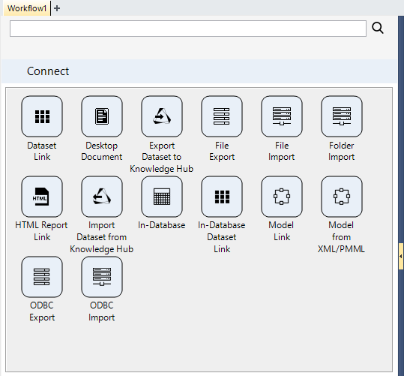
Connecting to Data
Use nodes from the Connect palette to:
Import a data file
Import multiple files at a time
Connect to data in a database
Import a model from an external source
Link to an existing dataset in the same or another Knowledge Studio project
Connect to auxiliary files
Export a file
Export to a database

Slide 4
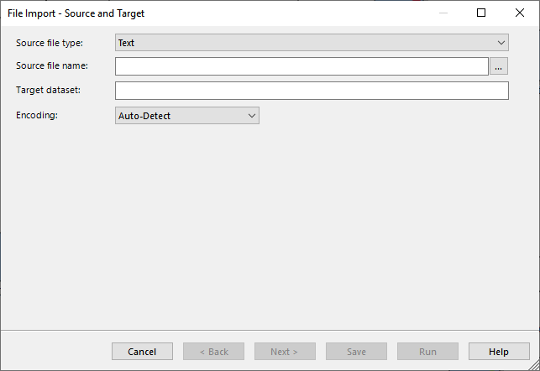

Importing Data Files
Use a File Import node
Wizard Page 1:
Specify file type and name
Specify the name of the dataset object to be created
Specify the encoding (rarely necessary)
Demo

Slide 5
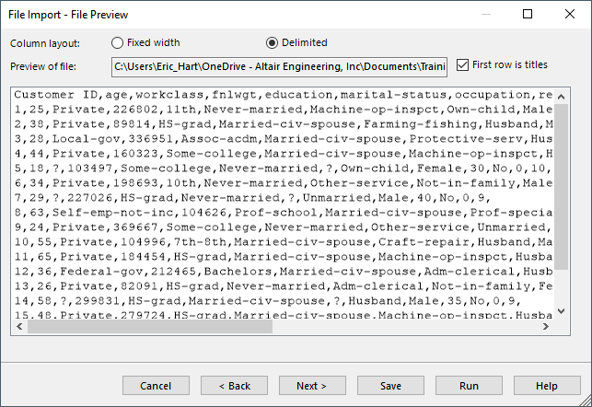
Importing Text Files
Wizard Page 2 (for Text files):
Specify whether file is fixed width or delimited
Specify if the file contains titles (in the first row)

Slide 6
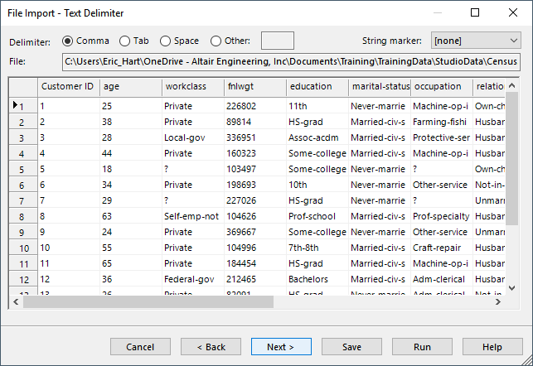
Importing Text Files
Wizard Page 3 (for Text files):
Specify delimiter
Specify string marker

Slide 7
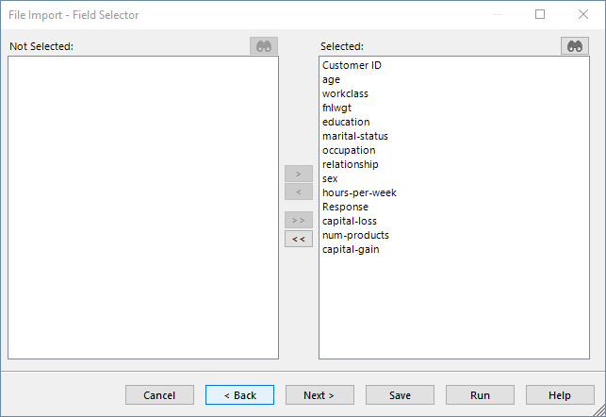
Importing Text Files
Wizard Page 4 (for Text files):
Select fields to include

Slide 8
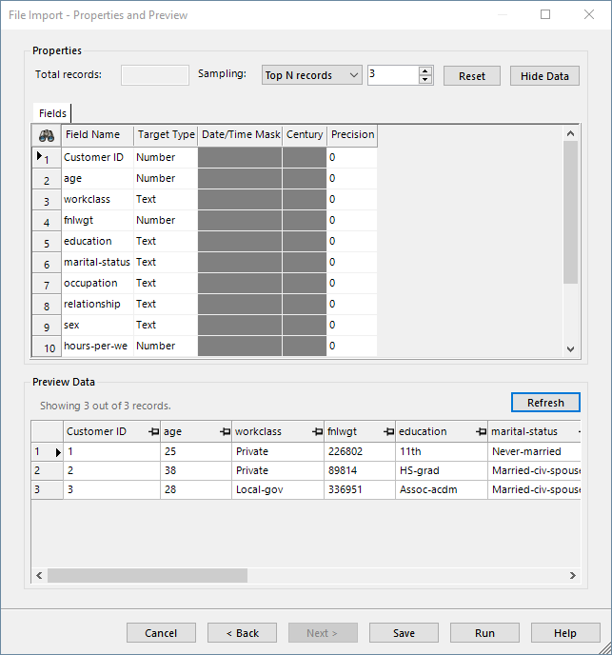
Importing Text Files
Wizard Page 5 (for Text files):
Change field names (uncommon)
Set field types
Default will be a guess based on the first 50 records
This can be a source of problems, most commonly for fields with a lot of nulls
Define date/time masks
Set precision
Integer between -16 and 16
2 means keep 2 decimal places
-2 means round to the nearest hundred
0 means keep everything
Import a sample
Preview data

Slide 9
Independent and Dependent Variables
When modelling, distinguish between Dependent and Independent variables (DVs and IVs)
The Dependent Variable: what we are trying to model/understand/predict
When we use our model, we don’t expect to know the value of this for new records
The Independent Variables: what we use to help predict the dependent variable
When we use our model, we expect to have access to the independent variables of the new records in order to help predict the dependent variable for those records
Some models allow prediction of multiple dependent variables at the same time
These are outside the scope of this course
Most models make use of multiple independent variables
Any that don’t, would be considered horribly ineffective by most modern standards

Slide 10
Variable Types
Knowledge Studio has 6 types of variables:
Number, Integer, Boolean, String, Date, Timestamp
For modelling purposes, we distinguish between 2 types of DVs
Discrete and Continuous
Discrete variables lead to classification problems
Continuous variables lead to regression problems
For modelling purposes, we distinguish between 3 types of IVs:
Continuous
Any numeric variables, including integers, get type “continuous” for modelling
Ordinal
These are variables which are naturally ordered, but the differences between levels doesn’t have meaning
Example: High/Medium/Low
Nominal
These are categorical variables where there is no natural ordering

Slide 11
Chapter 4: Exercises
To become familiar with the various import node procedures, import the following files using the appropriate node:
Census.xlsx
Census.txt
Census.csv
Right click the Import node and explore available options
Add some other nodes and connect to form an extended Workflow

